Slide 1


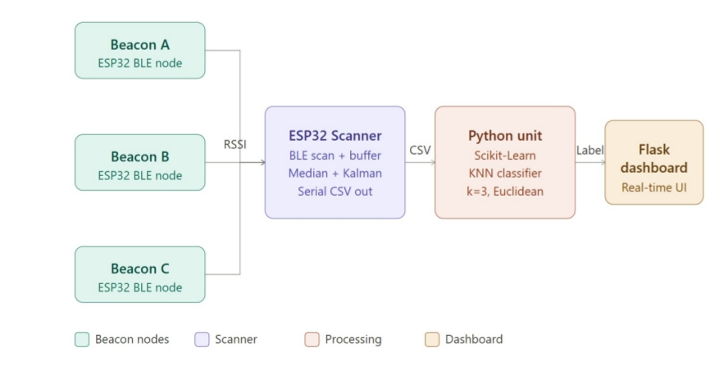
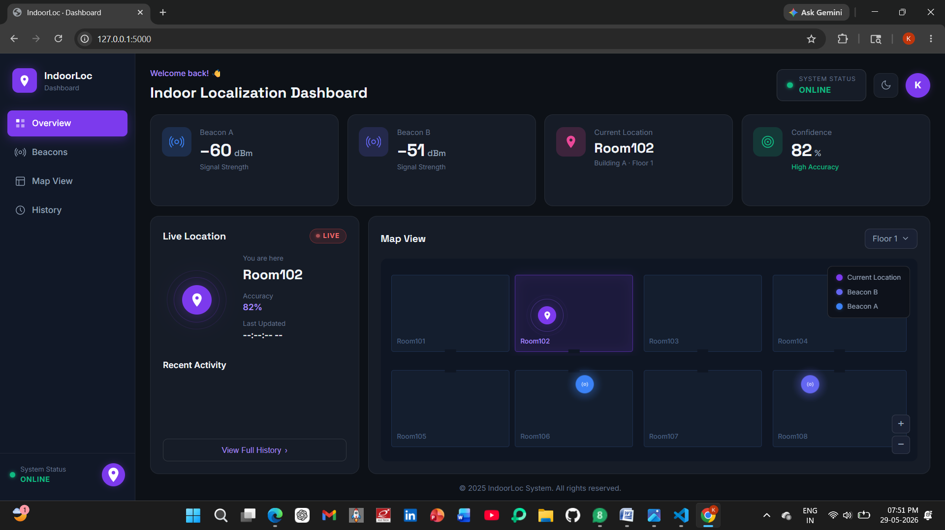
Title: Real-Time Indoor Localization System Using BLE
Beacon RSSI Fingerprinting and KNN Classification
Names of students :Parth Jadhav ,Md. Danish Shamsher ,Roopashree Pote ,Keerti Mahantshetti
Under guidance of :Prof. Pavan Chavalagi
Department of Electronics and Communication Engineering
Problem statement
Results
Accurate indoor human localization remains a challenging task because GPS signals are unreliable inside buildings due to attenuation, multipath propagation, and signal reflections. Variations in wireless signal strength further affect positioning accuracy. Therefore, there is a need for a low-cost and reliable indoor localization system capable of providing real-time location estimation in indoor environments.
Achieved 93.42% localization accuracy using the KNN algorithm.
Successfully identified Room101 and Room102 with 100% confidence.
RSSI filtering techniques significantly reduced signal noise and improved stability.
Enabled real-time indoor location prediction using low-cost ESP32 and BLE beacons.
Objectives
To develop a low-cost indoor localization system using BLE beacons and an ESP32 scanner for real-time position estimation.
To collect and preprocess RSSI signals using Median Filtering, Weighted Averaging, and Kalman Filtering techniques to improve signal stability and reduce noise.
To design and train a K-Nearest Neighbors (KNN) machine learning model for predicting indoor locations such as Room101, Room102, and Corridor based on RSSI fingerprints.
To develop a Flask-based real-time dashboard for monitoring RSSI values, location predictions, confidence scores, and status.
Optimization details
Applied Median, Weighted Average, and Kalman Filters to minimize RSSI noise and improve signal stability.
Optimized KNN classifier (k = 3) to achieve accurate room-level localization.
Used Euclidean distance metric for efficient and reliable location prediction.
Implemented a real-time RSSI processing pipeline on low-cost ESP32 hardware for fast response..
Contributions
Final Implementation
Developed a BLE-based indoor localization system using ESP32 and Bluetooth Low Energy beacons. Collected and processed RSSI fingerprints for real-time indoor positioning. Implemented signal preprocessing using Median Filter, Weighted Averaging, and Kalman Filter techniques. Trained and evaluated machine learning models for location prediction. Developed a Flask-based dashboard for real-time visualization of beacon signals, confidence scores, and predicted locations.
Conclusions
Literature survey
This project developed a real-time indoor localization system using BLE Beacon RSSI Fingerprinting and the KNN algorithm with ESP32 devices. By applying RSSI filtering techniques, signal noise was reduced and location prediction accuracy was improved. The system achieved 93.42% accuracy, demonstrating that BLE-based localization is a cost-effective and reliable solution for indoor navigation, asset tracking, and smart building applications.
• Several researchers have proposed BLE-based indoor localization systems that utilize RSSI fingerprinting techniques for estimating user positions in indoor environments.
• Machine learning algorithms such as K-Nearest Neighbors (KNN), Support Vector Machines (SVM), and Random Forest have been widely employed to improve localization accuracy using RSSI measurements.
• Various signal preprocessing methods, including Median Filtering, Kalman Filtering, and Weighted Averaging, have been applied to reduce RSSI fluctuations caused by multipath propagation and environmental interference.
Minor Project-2025-26

